Slide 1

Customer Shopping Behavior Analysis
Analyzing 3,900 customer transactions to uncover insights into spending patterns, product preferences, and subscription behavior for strategic business decisions.

Slide 2
Dataset Overview
3,900
18
$59.76
3.75
Total Purchases
Data Points
Avg Purchase
Avg Rating
Transactions analyzed across all categories
Features tracking demographics and behavior
Mean transaction value per customer
Customer satisfaction score
Customer Demographics
Shopping Behavior
Age, Gender, Location
Product Categories & Preferences
Subscription Status
Discount & Promo Usage
Purchase History
Shipping Type Selection

Slide 3

Data Preparation & Cleaning
01
Data Loading & Exploration
Imported dataset using pandas, analyzed structure with df.info() and summary statistics
02
Missing Data Handling
Imputed 37 missing Review Rating values using median rating per product category
03
Feature Engineering
Created age_group bins and purchase_frequency_days columns for deeper analysis
04
Database Integration
Connected to PostgreSQL and loaded cleaned data for SQL analysis

Slide 4
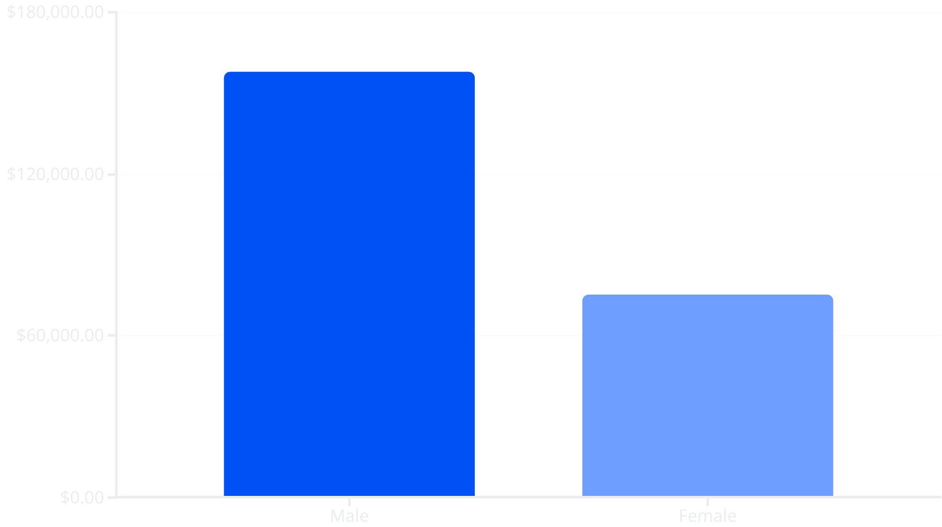
Revenue Analysis by Gender
Key Finding
Male customers generate 2.1x more revenue than female customers, representing 68% of total revenue.
This suggests opportunities for targeted marketing campaigns to balance gender engagement.

Slide 5
Product Performance Insights
Top Rated: Gloves
Sandals
Boots
3.86 average rating - highest customer satisfaction
3.84 rating - strong seasonal performer
3.82 rating - consistent quality perception
Discount-Dependent Products
High-Value Discount Users
Hat (50%), Sneakers (49.66%), Coat (49.07%) show highest discount usage rates
839 customers used discounts but still spent above average - smart shoppers seeking value

Slide 6




Customer Segmentation
80%
18%
2%
Loyal Customers
Returning
New Customers
3,116 customers with strong repeat purchase behavior
701 customers showing growth potential
83 first-time buyers to nurture
Strategic Opportunity: With 80% loyal customers, focus on converting the 18% returning segment through targeted loyalty programs and personalized offers.

Slide 7



Subscription Analysis
Revenue Comparison
Subscribers: $62,645 total ($59.49 avg)
Non-subscribers: $170,436 total ($59.87 avg)
27%
Similar average spend suggests subscription benefits aren't driving higher individual purchases - opportunity to enhance value proposition.
Subscribers
1,053 customers
73%
Non-Subscribers
2,847 customers

Slide 8
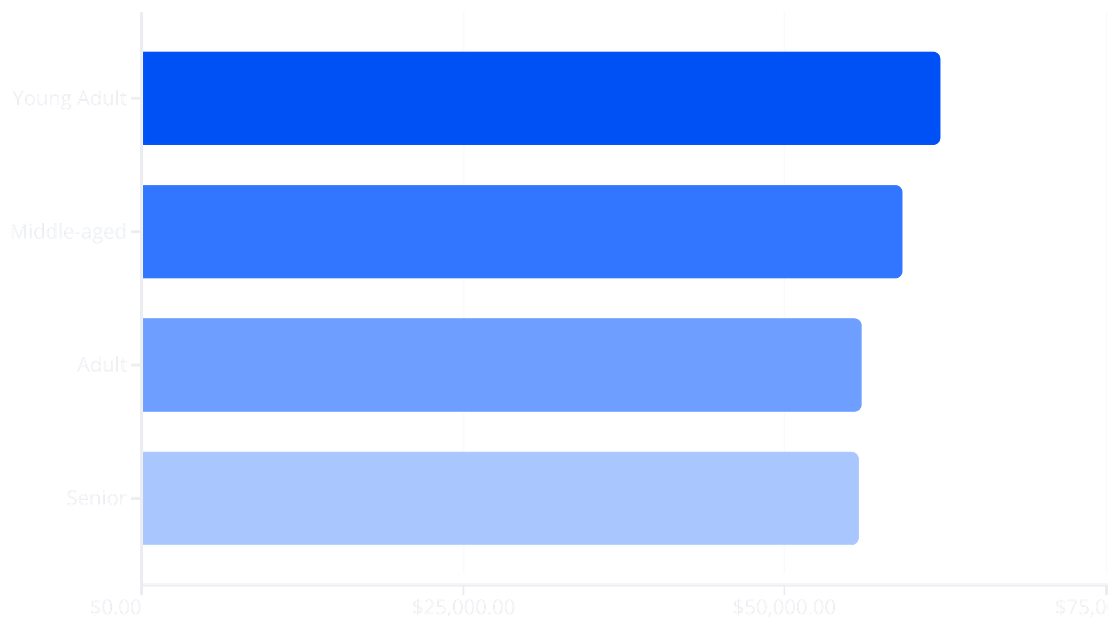
Revenue by Age Group & Category
Clothing
Accessories
Leading category: Blouse (171), Pants (171), Shirt (169) top sellers
Strong performance: Jewelry (171), Sunglasses (161), Belt (161)
Footwear
Outerwear
Consistent demand: Sandals (160), Shoes (150), Sneakers (145)
Seasonal strength: Jacket (163), Coat (161)

Slide 9

Shipping Preferences & Impact
60%
Express Shipping
$60.48 average purchase
58%
Standard Shipping
$58.46 average purchase
Express shipping users spend 3.5% more on average, indicating higher-value customer segment willing to pay for convenience.

Slide 10






Strategic Recommendations
Boost Subscriptions
Loyalty Programs
Review Discount Policy
Promote exclusive benefits and perks to convert the 73% non-subscriber base
Reward repeat buyers to strengthen the 80% loyal customer segment
Balance sales boosts with margin control for discount-dependent products
Targeted Marketing
Product Positioning
Focus on high-revenue age groups and express-shipping users for maximum ROI
Highlight top-rated items (Gloves, Sandals, Boots) in marketing campaigns

